Slide 1

Coding 101: Intro To Python
A readable, dynamic, pleasant,
flexible, fast and powerful language

Slide 2
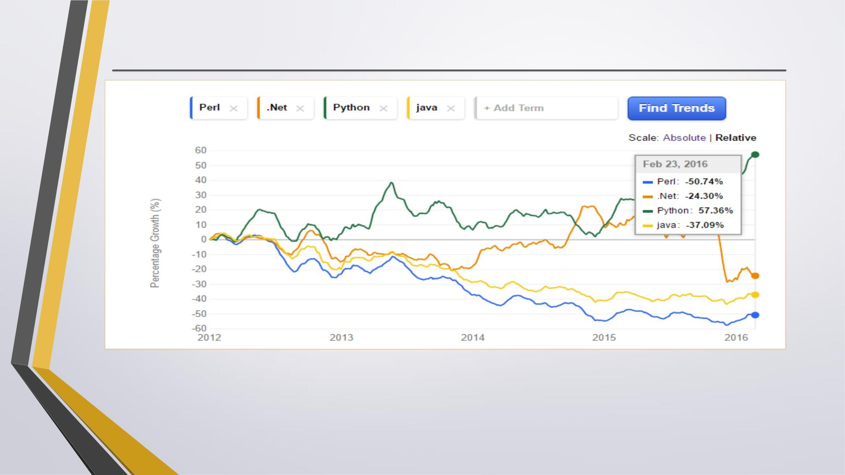
Job Trend
Per the indeed.com, percentage growth of Python is 500 times more than it’s peer Languages.
http://www.indeed.com/jobtrends?q=Perl%2C+.Net%2C+Python%2Cjava&l=&relative=1

Slide 3
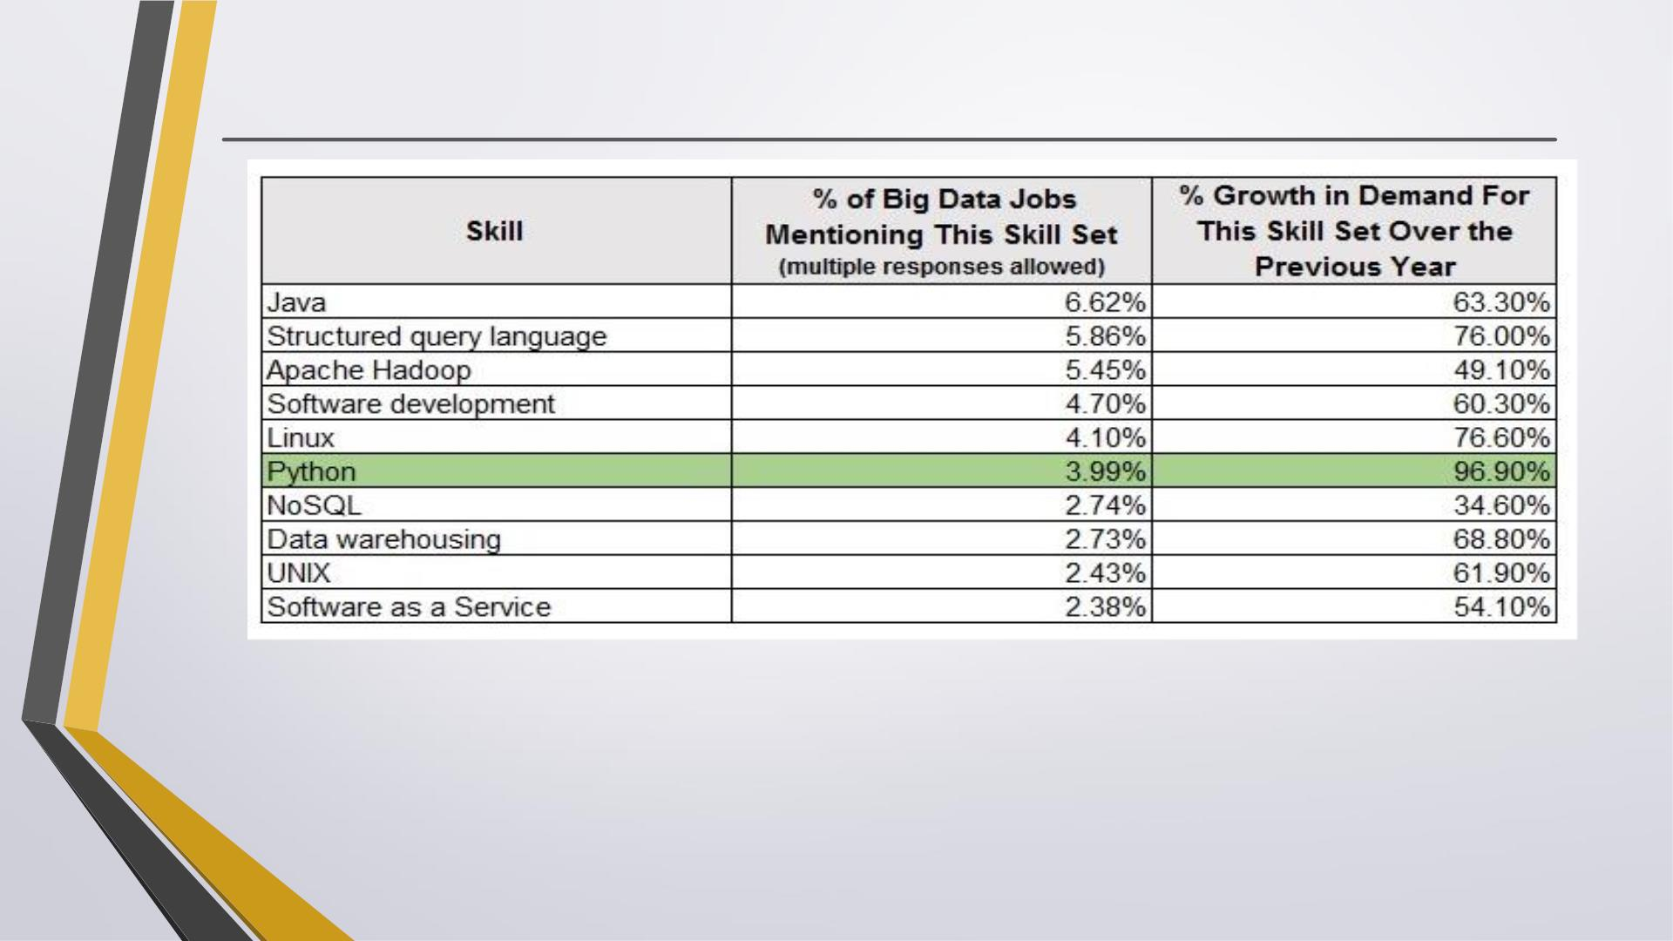
Job In Big Data space
Source: http://www.forbes.com/sites/louiscolumbus/2014/12/29/where-big-data-jobs-will-be-in-
2015/

Slide 4

What is Scripting Language?
• A scripting language is a “wrapper” language that integrates OS functions.
• The interpreter is a layer of software logic between your code and the computer
hardware on your machine.
Wiki Says:
• The “program” has an executable form that the computer can use directly to execute
the instructions.
• The same program in its human-readable source code form, from which executable
programs are derived (e.g., compiled)
• Python is scripting language, fast and dynamic.
• Python is called ‘scripting language’ because of it’s scalable interpreter, but actually it
is much more than that

Slide 5
What is Python?
Python is a high-level programming language which is:
. Interpreted: Python is processed at runtime by the interpreter. (Next Slide)
. Interactive: You can use a Python prompt and interact with the interpreter
directly to write your programs.
. Object-Oriented: Python supports Object-Oriented technique of programming.
. Beginner’s Language: Python is a great language for the beginner-level
programmers and supports the development of a wide range of applications.

Slide 6
Interpreters Versus Compilers
• The first thing that is important to understand about Python is that it is
an interpreted language.
• There are two sorts of programming languages: interpreted ones and
compiled ones. A compiled language is what you are probably used to if
you have done any programming in the past. The
• process for a compiled language is as follows:

Slide 7

• Create source file using text editor->
• Use compiler to syntax check and convert source file into binary ->
• Use linker to turn binary files into executable format->
• Run the resulting executable format file in the operating system.

Slide 8
• The biggest difference between interpreted code and compiled code is that
an interpreted application need not be “complete.”
• You can test it in bits and pieces until you are satisfied with the results and
put them all together later for the end user to use.

Slide 9
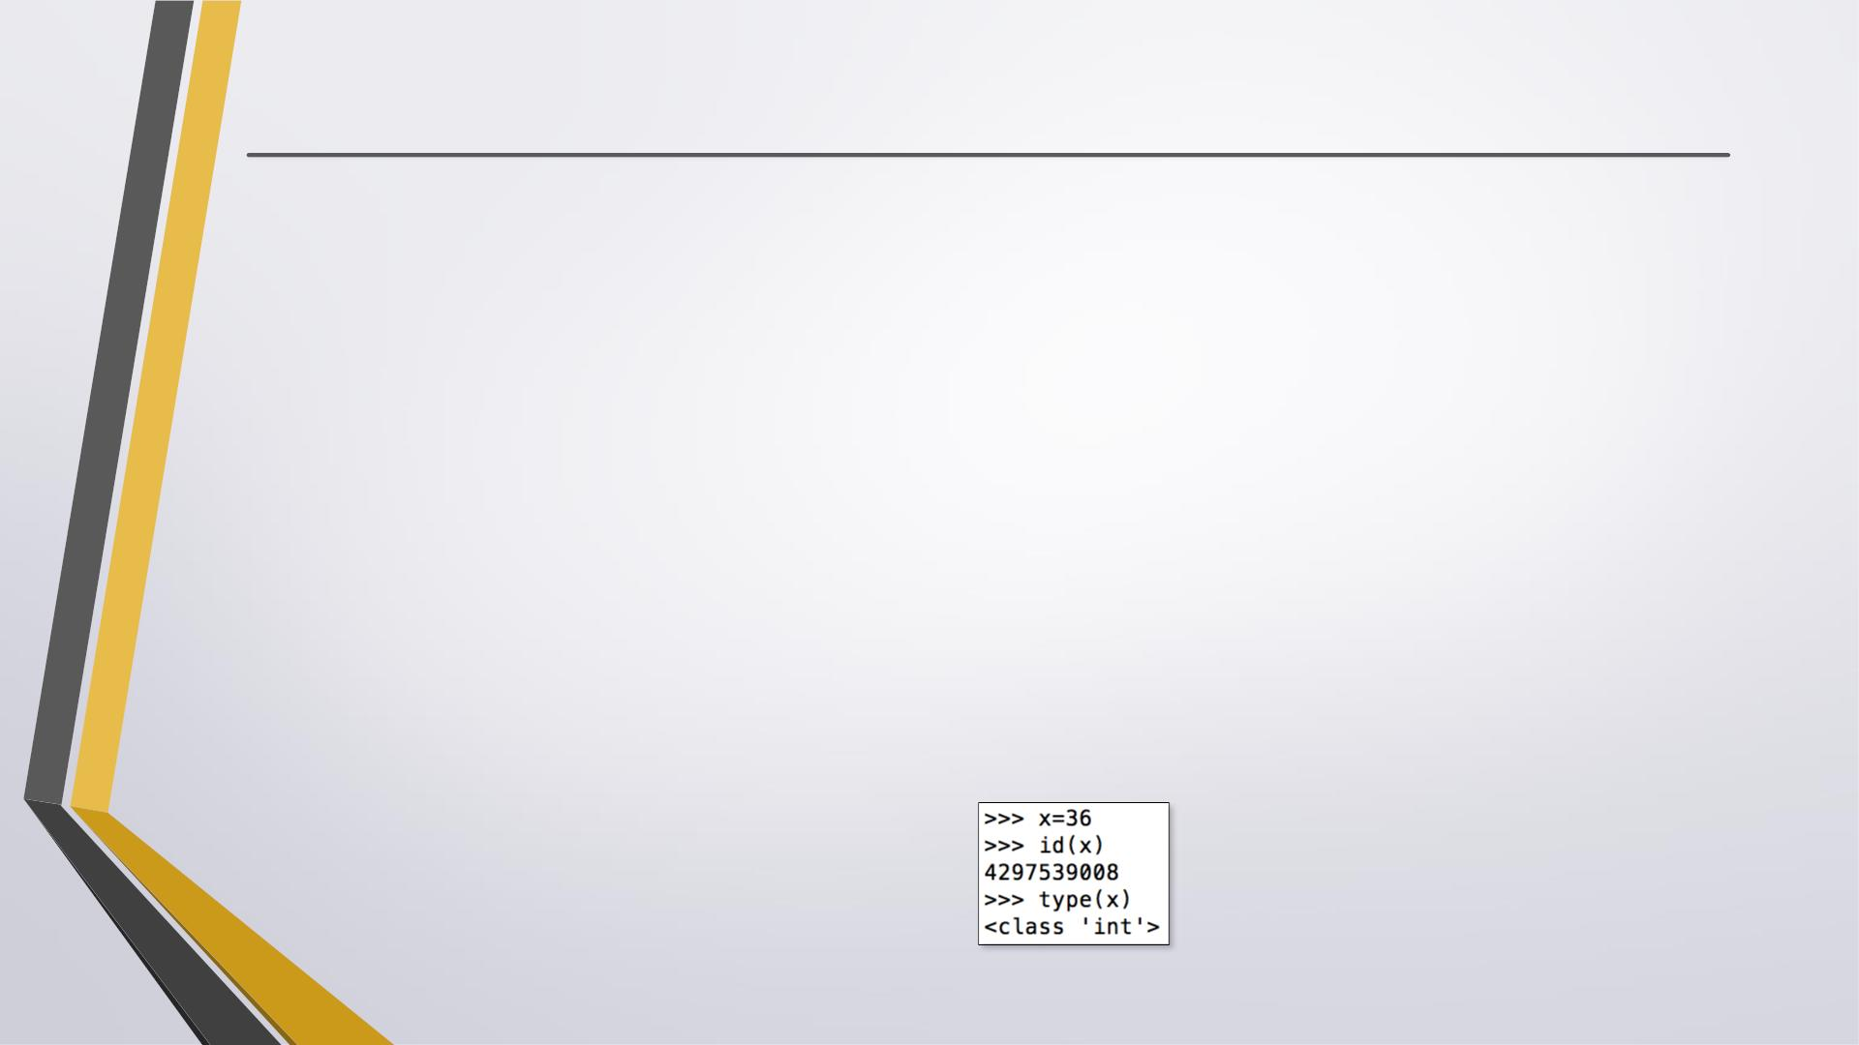
Python Features
. Easy to learn, easy to read and easy to maintain.
. Portable: It can run on various hardware platforms and has the same
interface on all platforms.
. Extendable: You can add low-level modules to the Python interpreter.
. Scalable: Python provides a good structure and support for large programs.
. Python has support for an interactive mode of testing and debugging.
. Python has a broad standard library cross-platform.
. Everything in Python is an object: variables, functions, even code. Every
object has an ID, a type, and a value.

Slide 10
More Features ..
. Python provides interfaces to all major commercial databases.
. Python supports functional and structured programming methods as well as
OOP.
. Python provides very high-level dynamic data types and supports dynamic
type checking.
. Python supports GUI applications
. Python supports automatic garbage collection.
. Python can be easily integrated with C, C++, and Java.

Slide 11
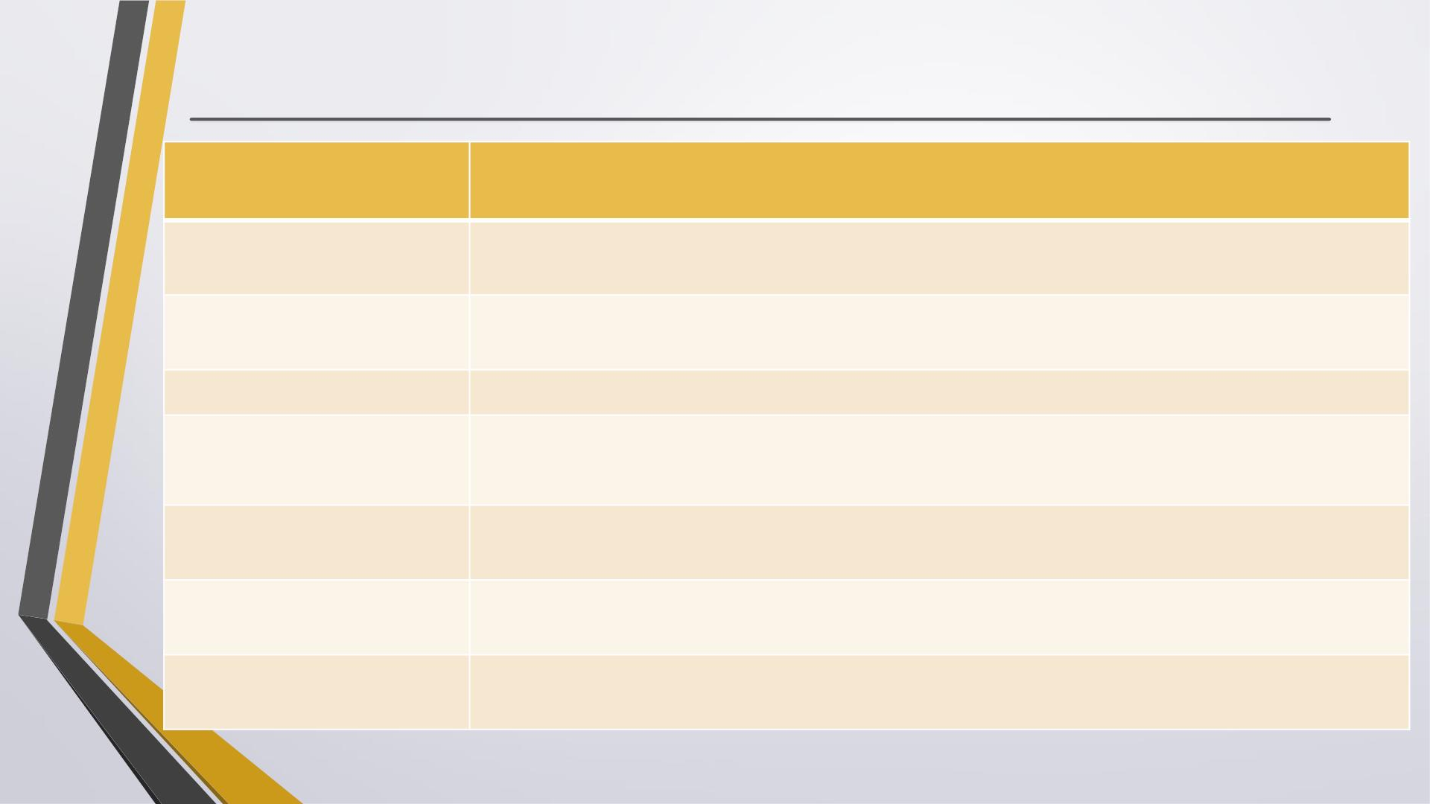
Why Python
Easy to read
✓ Python scripts have clear syntax, simple structure and very few protocols to
remember before programming.
Easy to Maintain
Portable
✓ Python code is easily to write and debug. Python's success is that its source code is fairly
easy-to-maintain.
✓ Python can run on a wide variety of Operating systems and platforms and providing the
similar interface on all platforms.
Broad Standard Libraries
High Level programming
✓ Python comes with many prebuilt libraries apx. 21K
✓ Python is intended to make complex programming simpler. Python deals with memory
addresses, garbage collection etc internally.
Interactive
✓ Python provide an interactive shell to test the things before implementation. It provide
the user the direct interface with Python.
Database Interfaces
GUI programming
✓ Python provides interfaces to all major commercial databases. These interfaces are
pretty easy to use.
✓ Python supports GUI applications and has framework for Web. Interface to tkinter,
WXPython, DJango in Python make it .
8/22/2017

Slide 12
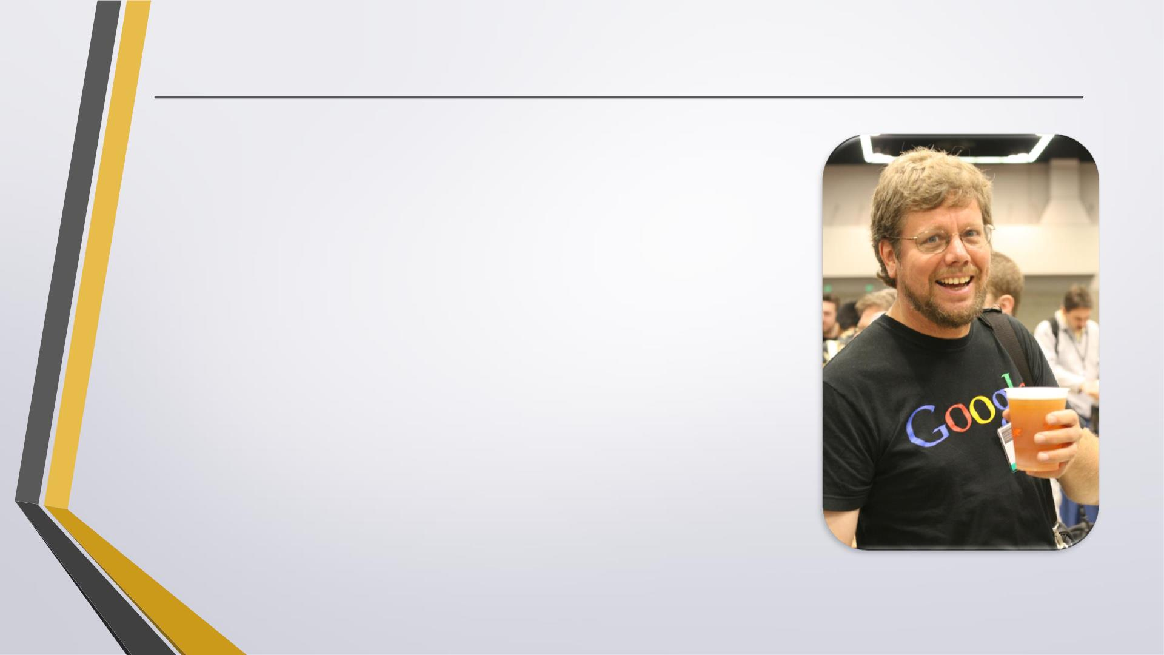
History of Python
. Python was conceptualized by Guido Van Rossum in the late
1980s.
. Rossum published the first version of Python code (0.9.0) in
February 1991 at the CWI (Centrum Wiskunde & Informatica)
in the Netherlands , Amsterdam.
. Python is derived from ABC programming language, which is a
general-purpose programming language that had been
developed at the CWI.
. Rossum chose the name "Python", since he was a big fan of
Monty Python's Flying Circus.
. Python is now maintained by a core development team at the
institute, although Rossum still holds a vital role in directing
its progress.
https://en.wikipedia.org/wiki/Guido_van_Rossum#/media/File:Guido_van_Rossum_OSCON_2006.jpg

Slide 13
Python Versions
Release dates for the major and minor versions:
Python 1.0 - January 1994
. Python 1.5 - December 31, 1997
. Python 1.6 - September 5, 2000
Python 2.0 - October 16, 2000
. Python 2.1 - April 17, 2001
. Python 2.2 - December 21, 2001
. Python 2.3 - July 29, 2003
. Python 2.4 - November 30, 2004
. Python 2.5 - September 19, 2006
. Python 2.6 - October 1, 2008
. Python 2.7 - July 3, 2010

Slide 14
Python Versions
Release dates for the major and minor versions:
Python 3.0 - December 3, 2008
. Python 3.1 - June 27, 2009
. Python 3.2 - February 20, 2011
. Python 3.3 - September 29, 2012
. Python 3.4 - March 16, 2014
. Python 3.5 - September 13, 2015

Slide 15
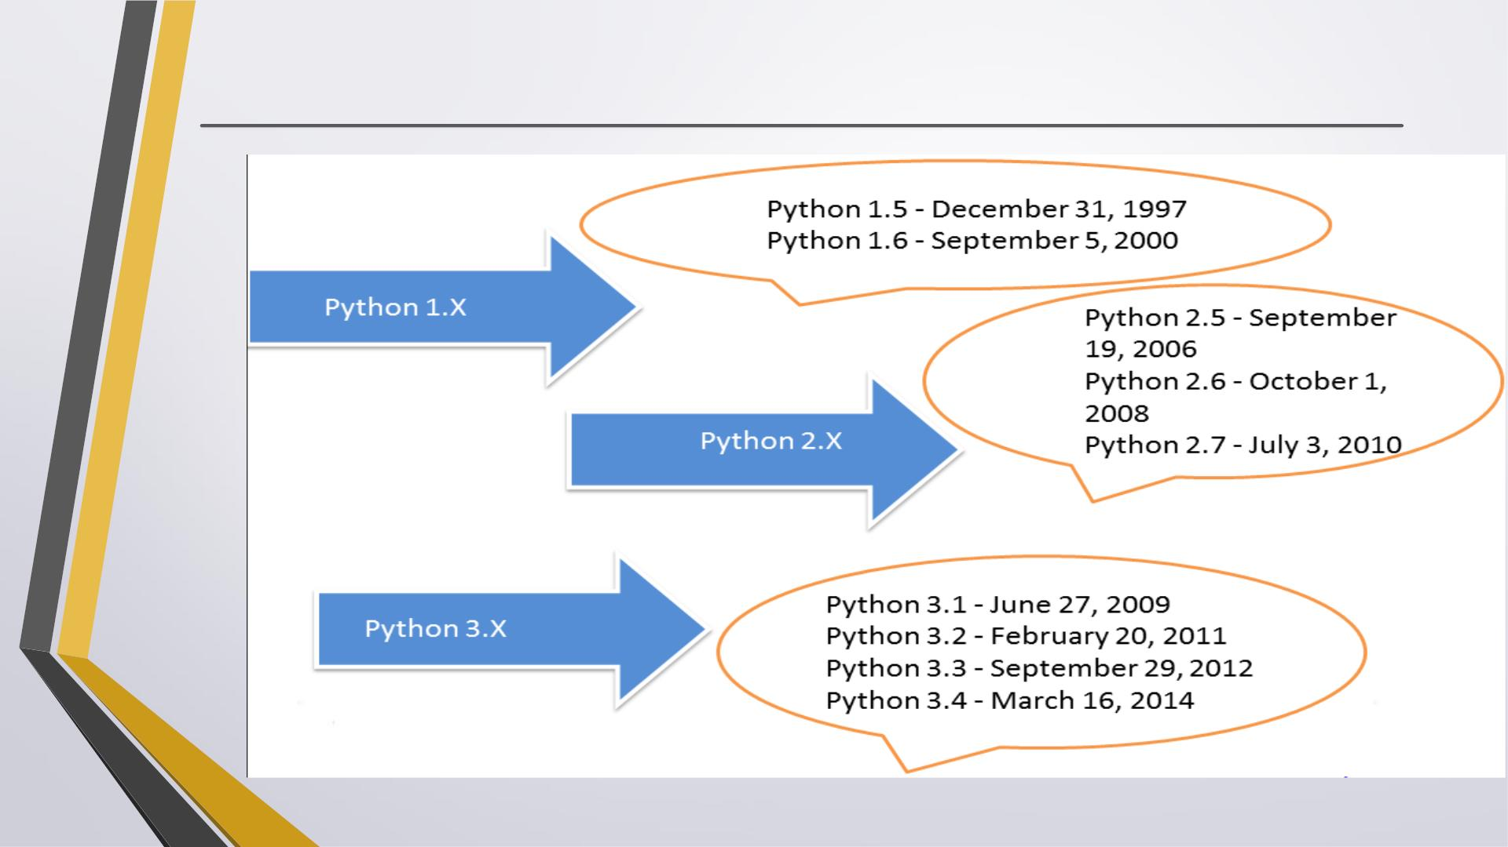
Python time line

Slide 16
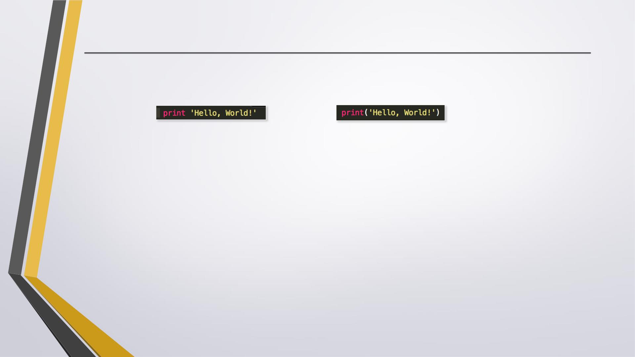
Key Changes in Python 3.0
✦ Python 2's print statement has been replaced by the print() function.
Old:
New:
✦ There is only one integer type left, int.
✦ Some methods such as map() and filter( ) return iterator objects in Python 3
instead of lists in Python 2.
✦ In Python 3, a TypeError is raised as warning if we try to compare unorderable
types. e.g. 1 < ’ ', 0 > None are no longer valid
✦ Python 3 provides Unicode (utf-8) strings while Python 2 has ASCII str( ) types
and separate unicode( ).
✦ A new built-in string formatting method format() replaces the % string
formatting operator.

Slide 17
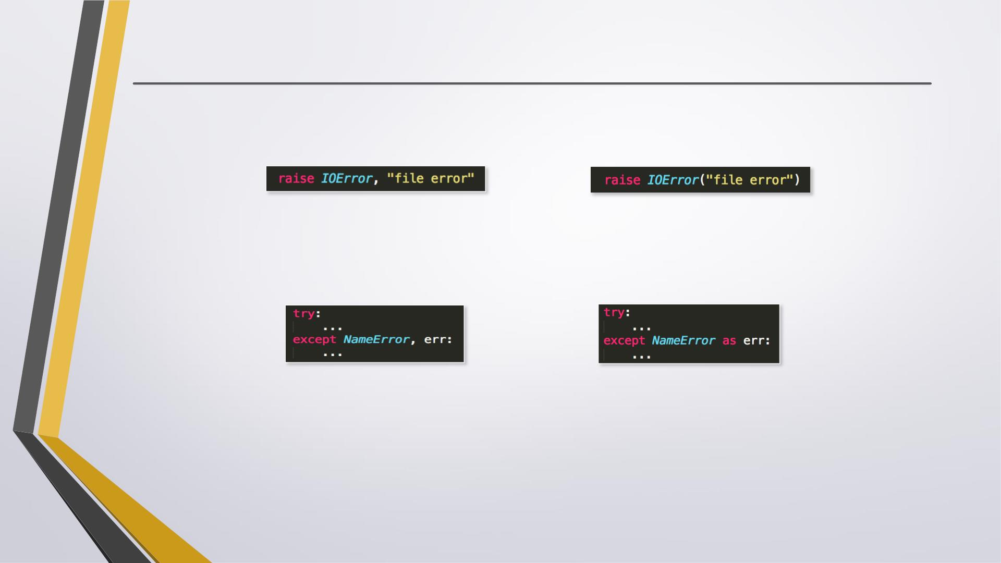
Key Changes in Python 3.0
✦ In Python 3, we should enclose the exception argument in parentheses.
Old:
New:
✦ In Python 3, we have to use the as keyword now in the handling of
exceptions.
Old:
New:
✦ The division of two integers returns a float instead of an integer. "//" can
be used to have the "old" behavior.

Slide 18
Python Syntax

Slide 19
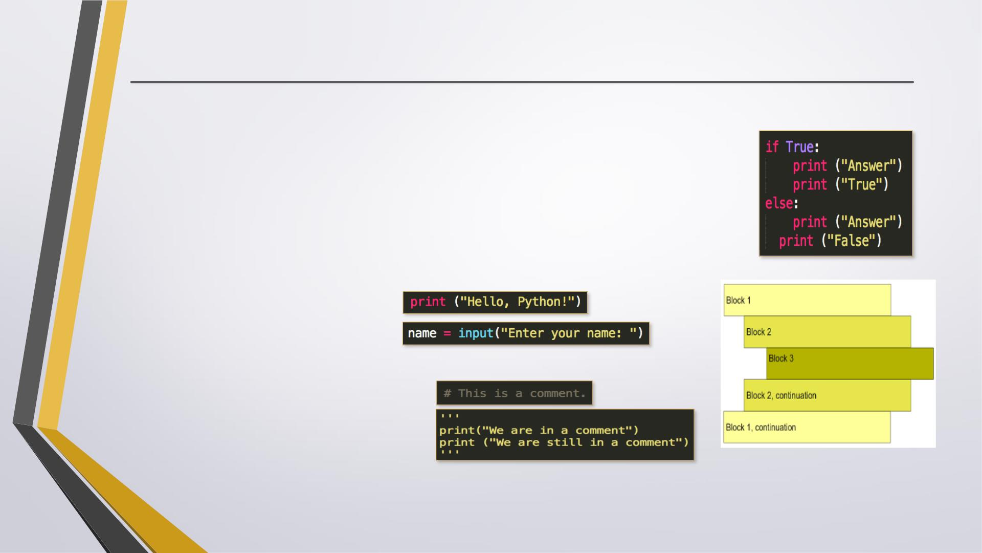
Basic Syntax
. Indentation is used in Python to delimit blocks. The number of spaces
is variable, but all statements within the same block must be
indented the same amount.
. The header line for compound statements, such as i f, while, def, and
class should be terminated with a colon ( : )
. The semicolon ( ; ) is optional at the end of statement.
→Error!
. Printing to the Screen:
. Reading Keyboard Input:
. Comments
•Single line:
•Multiple lines:
. Python files have extension .py

Slide 20
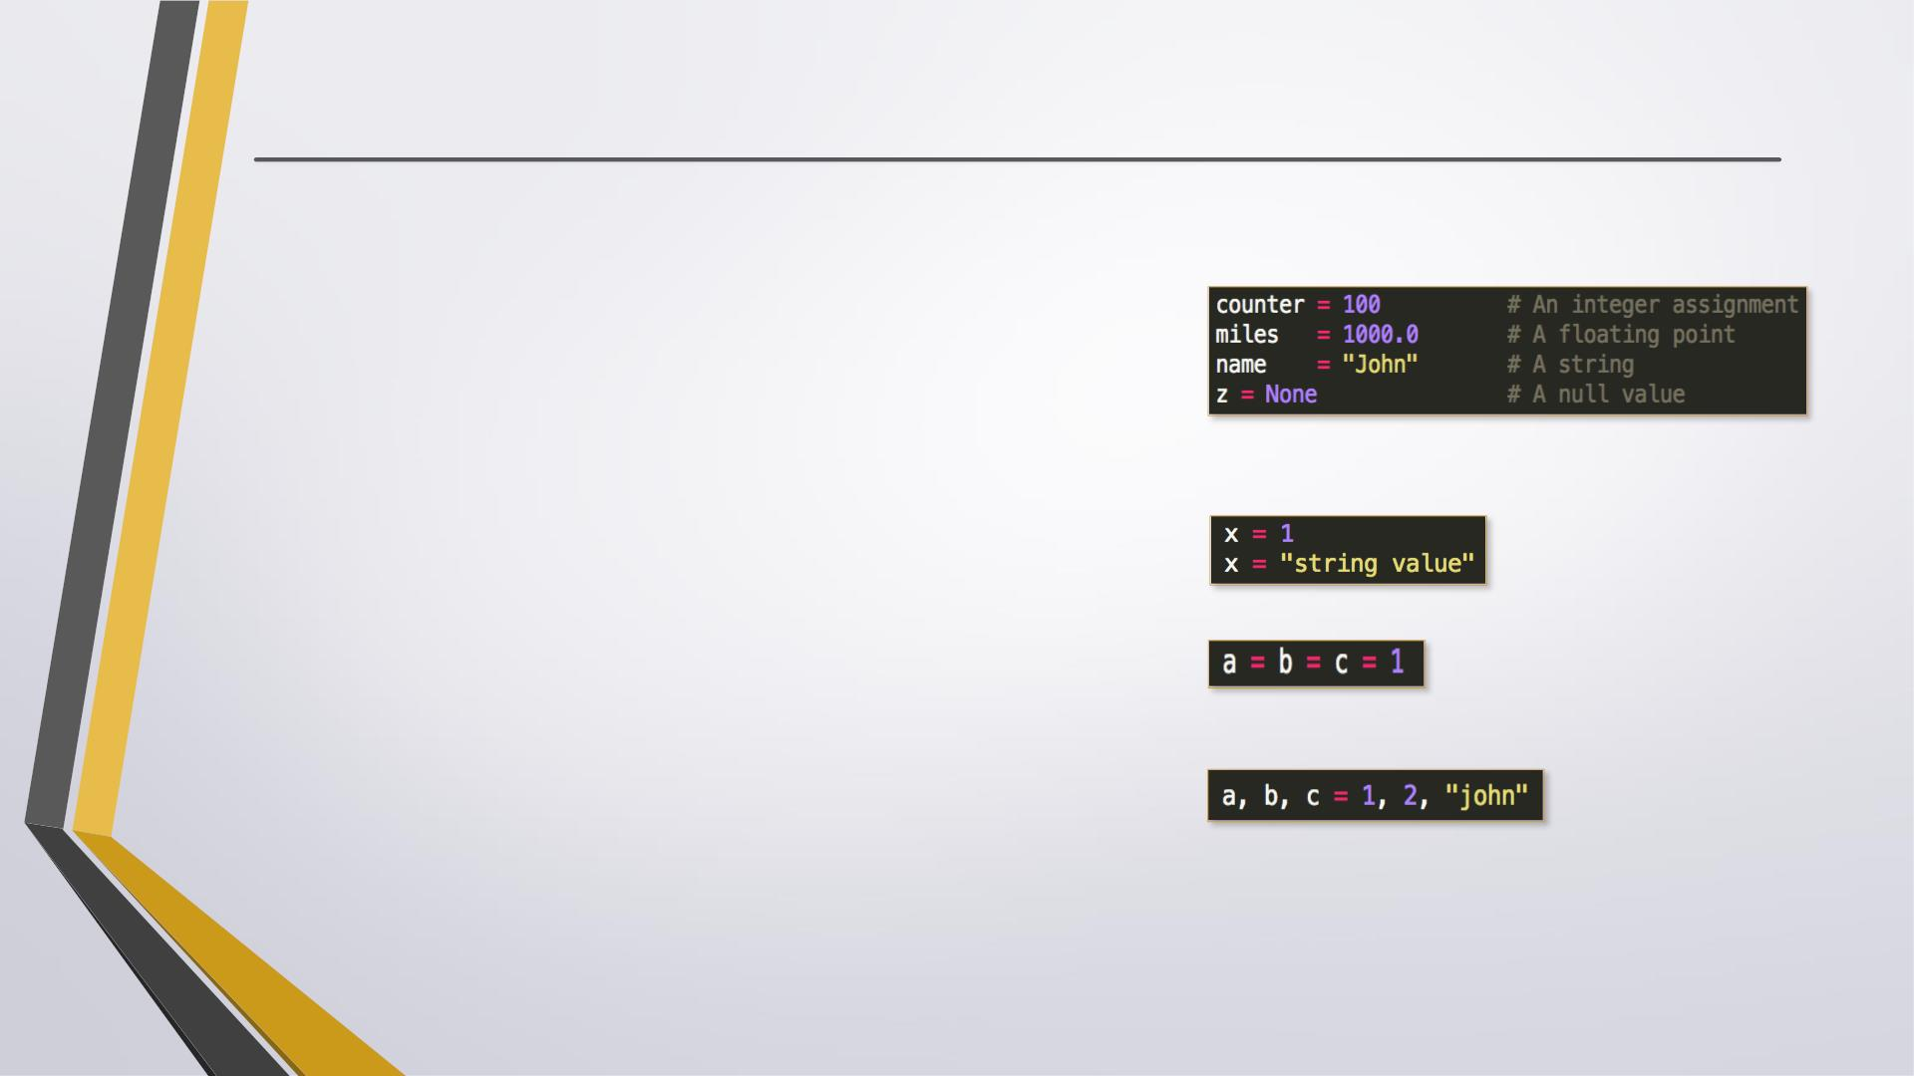
Variables
. Python is dynamically typed. You do not need to
declare variables!
. The declaration happens automatically when
you assign a value to a variable.
. Variables can change type, simply by assigning
them a new value of a different type.
. Python allows you to assign a single value to
several variables simultaneously.
. Yo u can also assign multiple objects to multiple
variables.

Slide 21
Python Data Types

Slide 22
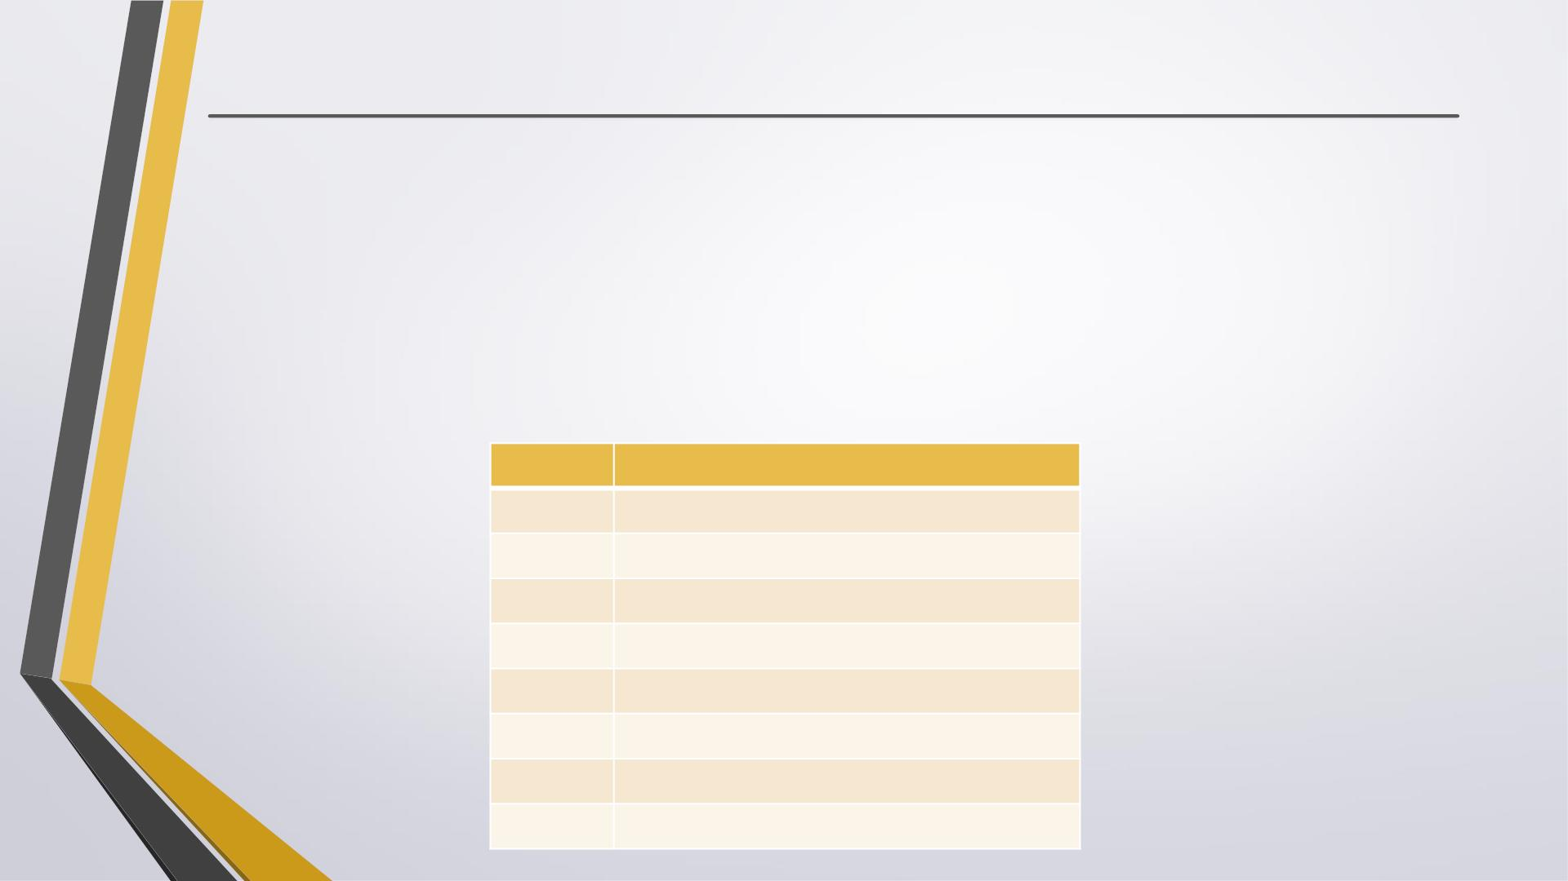
Numbers
. Numbers are Immutable objects in Python that cannot change their values.
. There are three built-in data types for numbers in Python3:
• Integer (ints range from -2147483648 through 2147483647)
• Floating-point numbers (float)
• Complex numbers: <real part> + <imaginary part>j (not used much in Python programming)
. Common Number Functions
Function Description
int(x)
to convert x to an integer
float(x)
abs(x)
to convert x to a floating-point number
The absolute value of x
cmp(x,y) -1 if x < y, 0 if x == y, or 1 if x > y
exp(x)
log(x)
The exponential of x: e^{x}
The natural logarithm of x, for x> 0
pow(x,y) The value of x**y
sqrt(x) The square root of x for x > 0

Slide 23
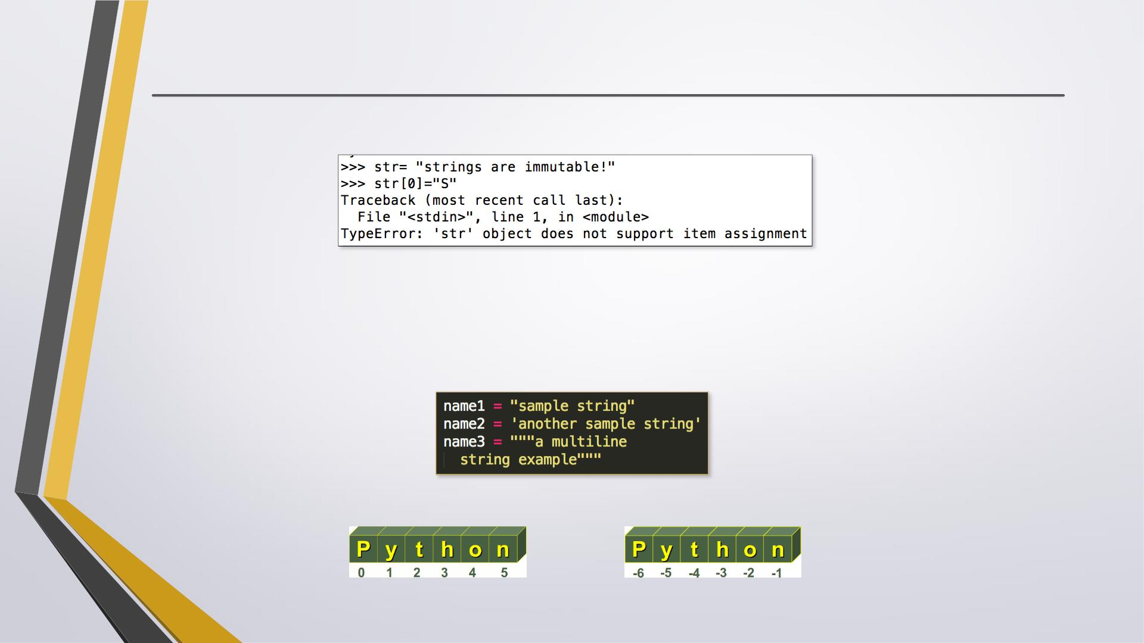
Strings
. Python Strings are Immutable objects that cannot change their values.
. You can update an existing string by (re)assigning a variable to another string.
. Python does not support a character type; these are treated as strings of length one.
. Python accepts single ('), double (") and triple (''' or """) quotes to denote string literals.
. String indexes starting at 0 in the beginning of the string and working their way from -1
at the end.

Slide 24
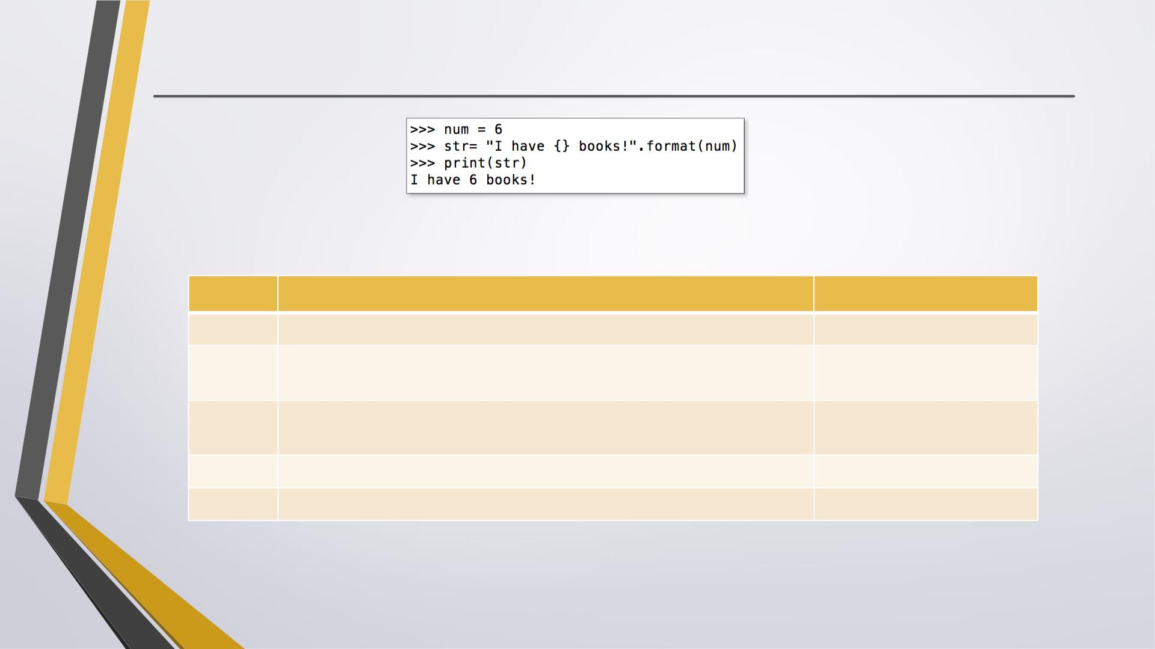
Strings
. String Formatting
. Common String Operators
Assume string variable a holds 'Hello' and variable b holds 'Python’
Operator
Description
Example
+
*
Concatenation - Adds values on either side of the operator
a + b will give HelloPython
Repetition - Creates new strings, concatenating multiple copies of a*2 will give HelloHello
the same string
[ ]
Slice - Gives the character from the given index
a[1] will give e
a[-1] will give o
[ : ]
in
Range Slice - Gives the characters from the given range
a[1:4] will give ell
Membership - Returns true if a character exists in the given string ‘H’ in a will give True

Slide 25
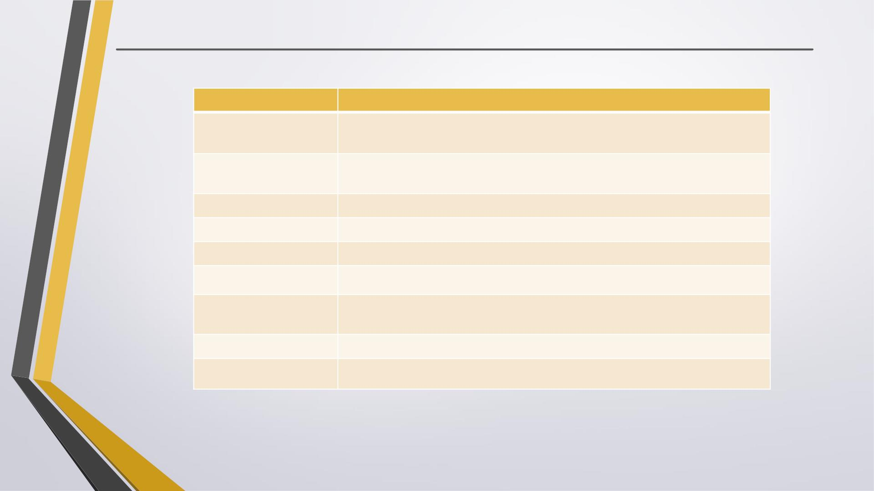
Strings
. Common String Methods
Method
Description
str.count(sub, beg=
0,end=len(str))
Counts how many times sub occurs in string or in a substring of string if
starting index beg and ending index end are given.
str.isalpha()
Returns True if string has at least 1 character and all characters are
alphanumeric and False otherwise.
str.isdigit()
Returns True if string contains only digits and False otherwise.
Converts all uppercase letters in string to lowercase.
Converts lowercase letters in string to uppercase.
Replaces all occurrences of old in string with new.
str.lower()
str.upper()
str.replace(old, new)
str.split(str=‘ ’)
Splits string according to delimiter str (space if not provided)
and returns list of substrings.
str.strip()
str.title()
Removes all leading and trailing whitespace of string.
Returns "titlecased" version of string.
. Common String Functions str(x) :to convert x to a string
len(string):gives the total length of the string

Slide 26
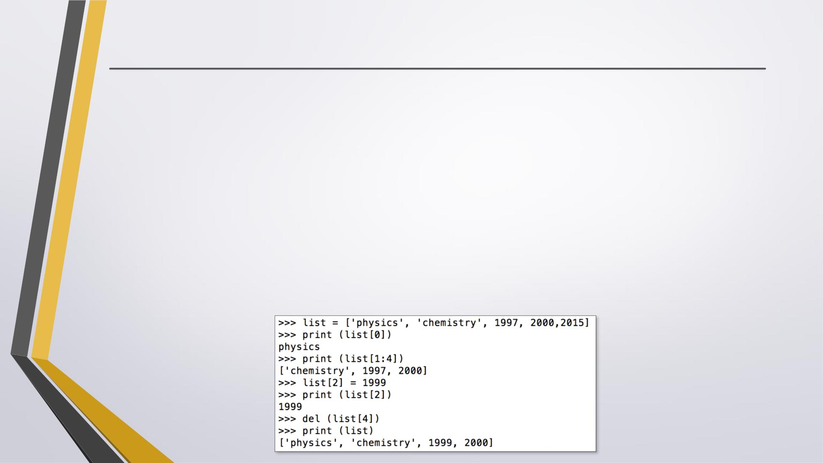
Lists
. A list in Python is an ordered group of items or elements, and these list elements don't
have to be of the same type.
. Python Lists are mutable objects that can change their values.
. A list contains items separated by commas and enclosed within square brackets.
. List indexes like strings starting at 0 in the beginning of the list and working their way
from -1 at the end.
. Similar to strings, Lists operations include slicing ([ ] and [:]) , concatenation (+),
repetition (*), and membership (in).
. This example shows how to access, update and delete list elements:
→ access
→ slice
→ update
→ delete

Slide 27
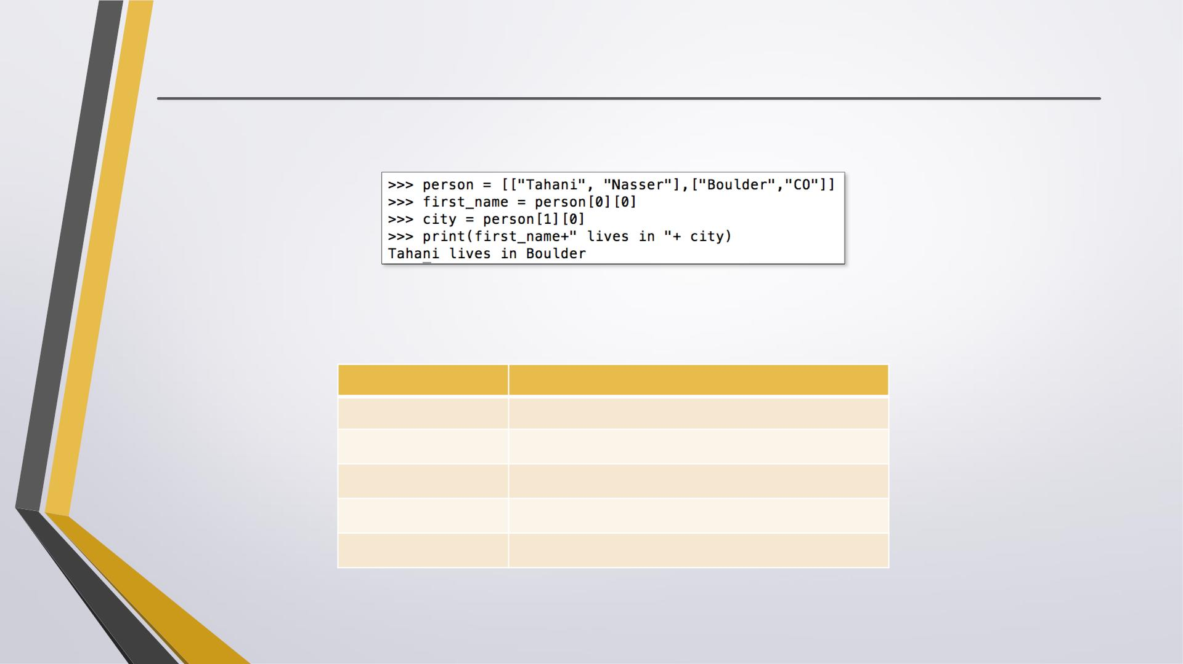
Lists
. Lists can have sublists as elements and these sublists may contain other sublists
as well.
. Common List Functions
Function
cmp(list1, list2)
len(list)
Description
Compares elements of both lists.
Gives the total length of the list.
Returns item from the list with max value.
Returns item from the list with min value.
Converts a tuple into list.
max(list)
min(list)
list(tuple)

Slide 28
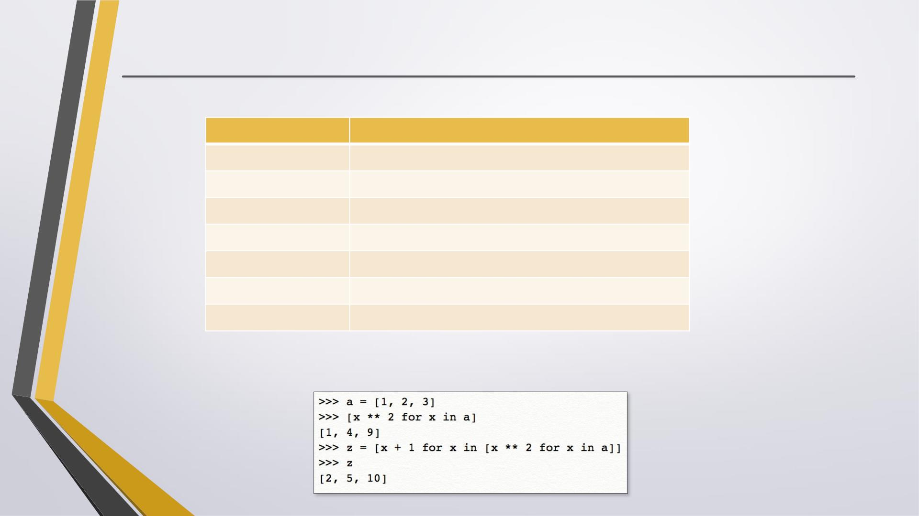
Lists
. Common List Methods
Method
Description
Appends object obj to list
list.append(obj)
list.insert(index, obj) Inserts object obj into list at offset index
list.count(obj)
list.index(obj)
list.remove(obj)
list.reverse()
list.sort()
Returns count of how many times obj occurs in list
Returns the lowest index in list that obj appears
Removes object obj from list
Reverses objects of list in place
Sorts objects of list in place
. List Comprehensions
Each list comprehension consists of an expression followed by a for clause.
→ List comprehension

Slide 29
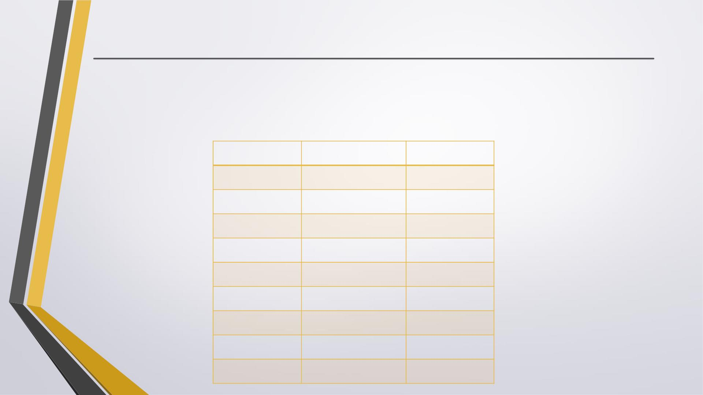
Python Reserved Words
A keyword is one that means something to the language. In other words, you can’t use a
reserved word as the name of a variable, a function, a class, or a module. All the Python
keywords contain lowercase letters only.
and
exec
finally
for
not
or
assert
break
class
pass
print
raise
return
try
while
with
yield
from
continue global
def
del
elif
else
if
import
in
is
except lambda

Slide 30
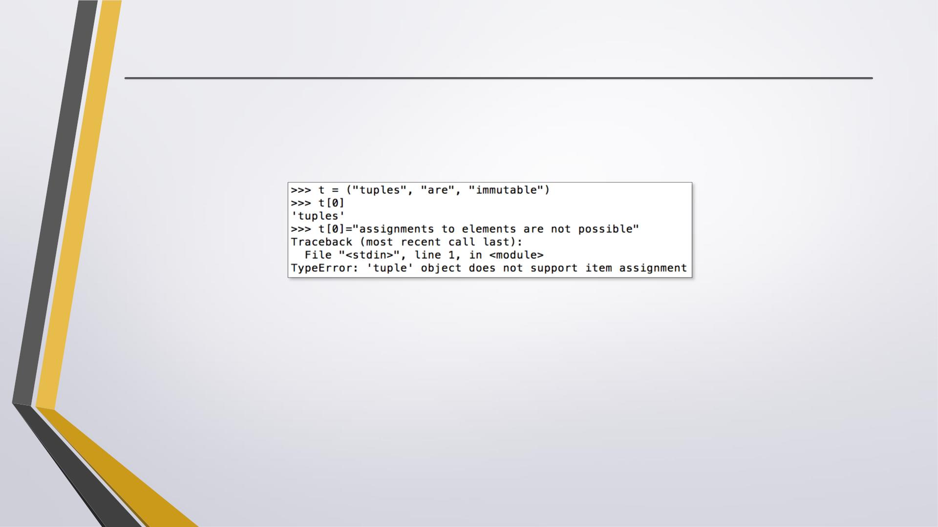
Tuples
. Python Tuples are Immutable objects that cannot be changed once they have been
created.
. A tuple contains items separated by commas and enclosed in parentheses instead of
square brackets.
→ access
→ No update
. You can update an existing tuple by (re)assigning a variable to another tuple.
. Tuples are faster than lists and protect your data against accidental changes to these data.
. The rules for tuple indices are the same as for lists and they have the same operations,
functions as well.
. To write a tuple containing a single value, you have to include a comma, even though there
is only one value. e.g. t = (3, )

Slide 31
Dictionary
. Python's dictionaries are kind of hash table type which consist of key-value pairs
of unordered elements.
• Keys : must be immutable data types ,usually numbers or strings.
• Values : can be any arbitrary Python object.
. Python Dictionaries are mutable objects that can change their values.
. A dictionary is enclosed by curly braces ({ }), the items are separated by commas,
and each key is separated from its value by a colon (:).
. Dictionary’s values can be assigned and accessed using square braces ([]) with a
key to obtain its value.

Slide 32
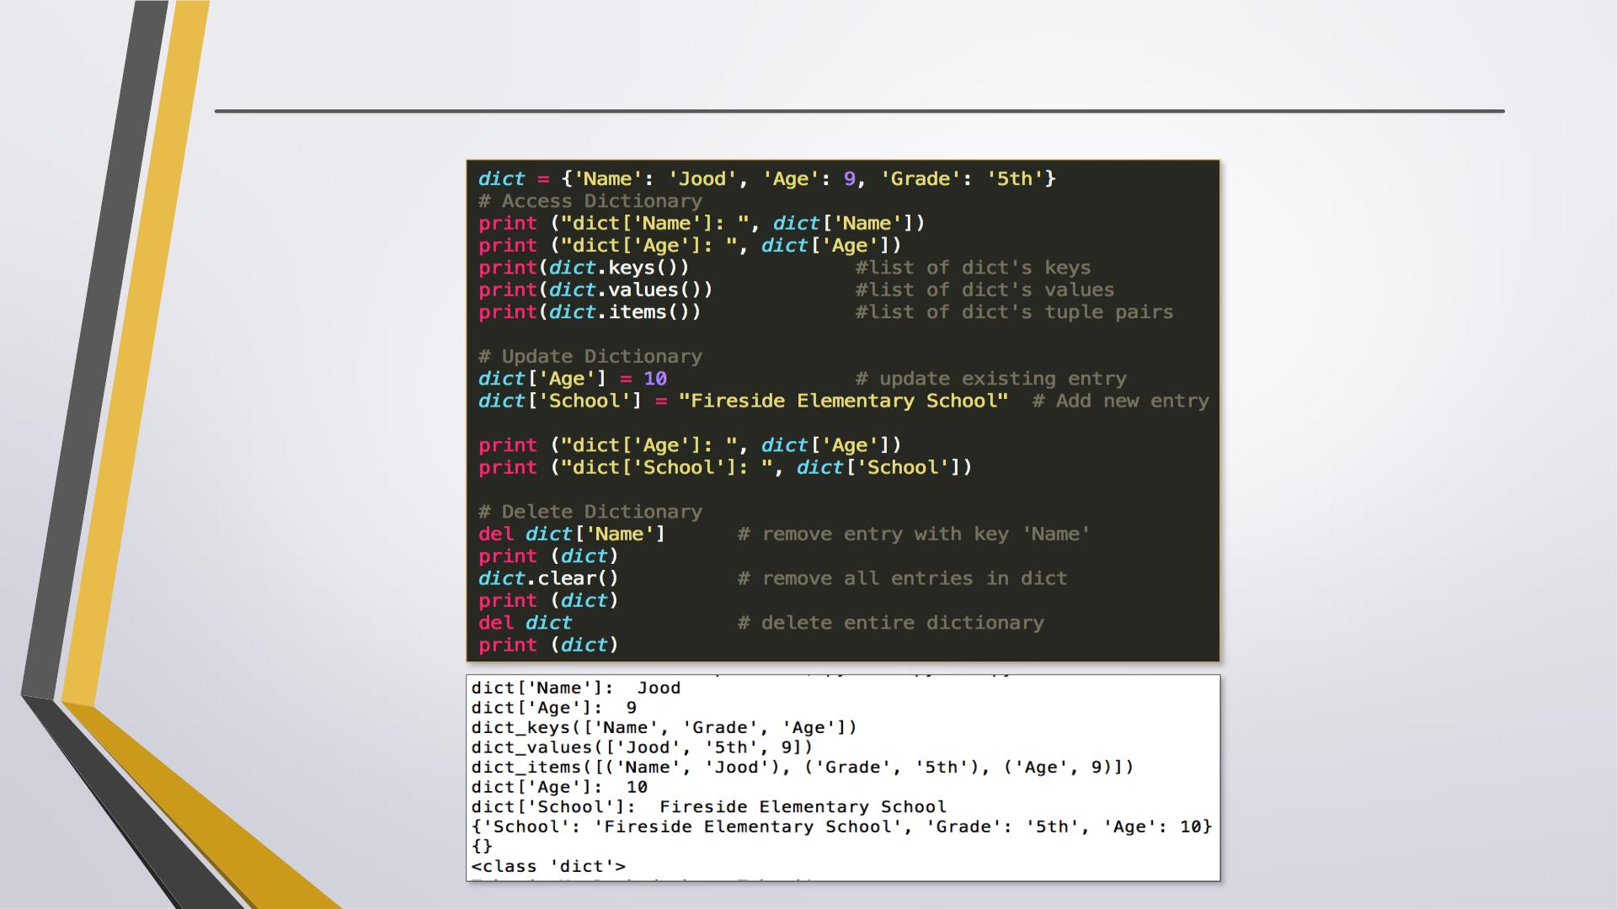
Dictionary
. This example shows how to access, update and delete dictionary elements:
. The output:

Slide 33
Tuesday Week 1 - Turtle
. turtle is a pre-installed Python library that enables users to create pictures and shapes by providing them with a virtual canvas.
. The onscreen pen that you use for drawing is called the turtle and this is what gives the library its name.

Slide 34
Tuesday Week 1 - Turtle
. You now have your screen and your turtle. The screen acts as a canvas, while the turtle acts like a pen. You can program the turtle to move around the screen.
. The turtle has certain changeable characteristics, like size, color, and speed. It always points in a specific direction, and will move in that direction unless you tell it otherwise

Slide 35
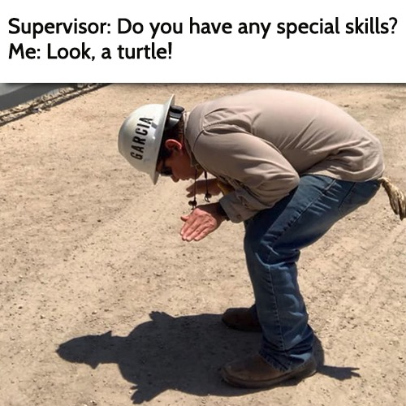
Tuesday Week 1 - Turtle
. The first thing you’ll learn when it comes to programming with the Python turtle library is how to make the turtle move in the direction you want it to go. Next, you’ll learn how to customize your turtle and its environment. Finally, you’ll learn a couple of extra commands with which you can perform some special tasks.

Slide 36
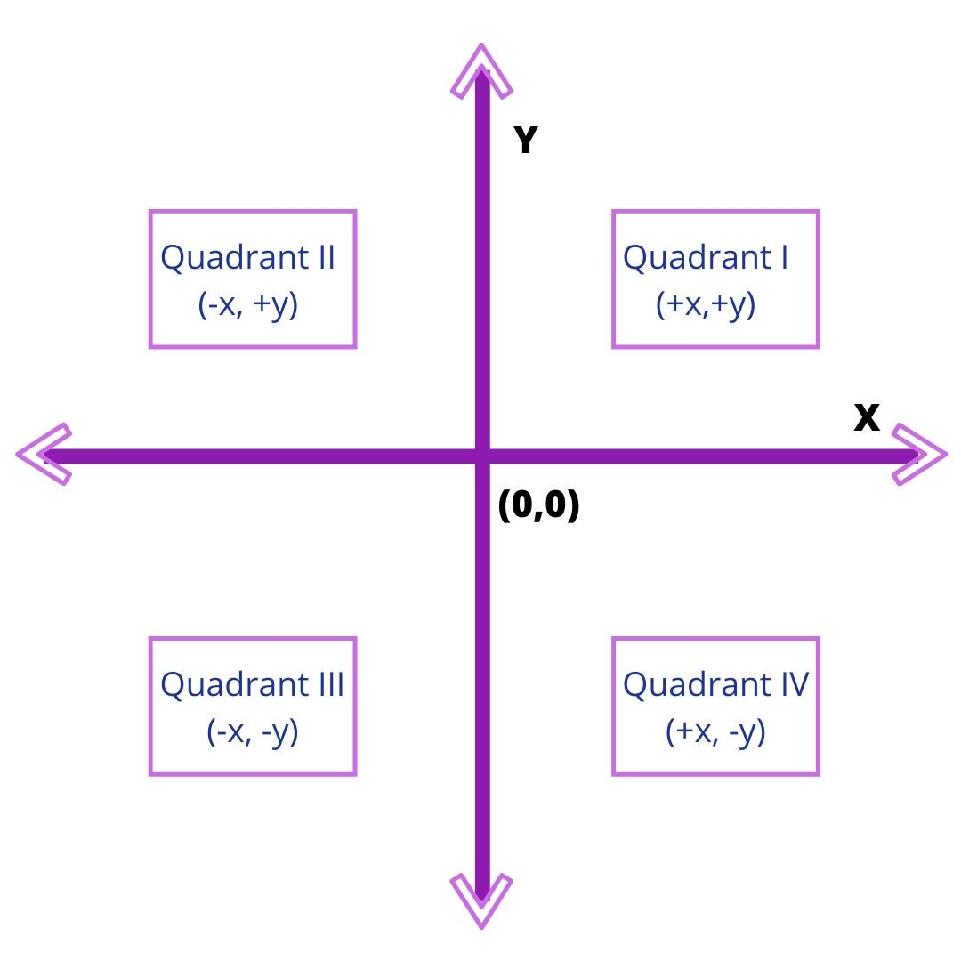
Tuesday Week 1 - Turtle
. You can also draw a line from your current position to any other arbitrary position on the screen. This is done with the help of coordinates.
. The screen is divided into four quadrants. The point where the turtle is initially positioned at the beginning of your program is (0,0). This is called Home. To move the turtle to any other area on the screen, you use .goto() and enter the coordinates like so

Slide 37
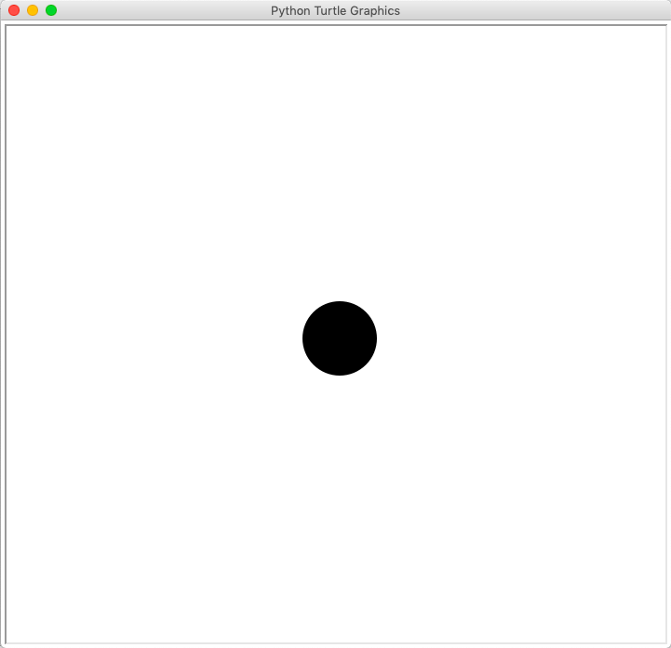
Turtle - Drawing Preset Figures
.Suppose you want to draw a circle. If you attempt to draw it in the same way as you drew the square, then it would be extremely tedious, and you’d have to spend a lot of time just for that one shape. Thankfully, the Python turtle library provides a solution for this. You can use a single command to draw a circle:
The number within the brackets is the radius of the circle. You can increase or decrease the size of the circle by changing the value of its radius.
In the same way, you can also draw a dot, which is nothing but a filled-in circle. Type in this command:

Slide 38
Turtle - Changing the Screen Color
. By default, turtle always opens up a screen with a white background. However, you can change the color of the screen at any time
You can replace "blue" with any other color. Try "green" or "red". You’ll get a result like this…You can use a variety of colors for your screen just by typing in their hex code number.
Sometimes, you may want to change the title of your screen. You can make it more personal, like "My Turtle Program", or more suitable to what you’re working on, like "Drawing Shapes With Turtle". You can change the title of your screen with the help of this command..

Slide 39
Turtle - Changing the Turtle Size
. You can increase or decrease the size of the onscreen turtle to make it bigger or smaller. This changes only the size of the shape without affecting the output of the pen as it draws on the screen. Try typing in the following commands…
The numbers given are the parameters for the size of the turtle:
Stretch length
Stretch width
Outline width
The previous command changed the size of the turtle’s shape only. However, sometimes, you may need to increase or decrease the thickness of your pen. You can do this using the following command..

